Slide 1
Movie Recommender Systems based on user’s search history using incremental clustering
Guide
Mr. J. SURYA KIRAN,
Asst. Professor
CSE DEPT, KLEF
By
180030308 K. Yasaswi
180030282 N. Sai Charitha
180039007-Safia Begum
180031300-Ch.Vyshnavi

Slide 2
Contents
Abstract
Introduction
Literature Survey
Problem Statement
Disadvantages of existing system
Advantages of proposed system
System Architecture

Slide 3
Abstract
In the present world as the technology is advancing there has been a drastic increase in the websites, which have numerous options for the products we wish to buy. When there a several options for a single product, one might be generally confused in making their choices. To avoid that, recommender systems plays a major role in recommending the items or products to the users, by using some algorithms and techniques. These recommender systems are used for various purposes like, in recommending music, movies, products, research papers, youtube, Netflix, temporal recommendation and so on. A recommender System gives suggestions based on the user’s interest using some algorithms like Clustering, and suggests the items based on the generated interests of the user in the coarse of time.

Slide 4
Introduction
The introduction of recommender systems could be traced back to 1979 with relation to cognitive science. Recommender systems are used more widely than other areas like approximation theory information retrieval, forecasting theories.
The common problem faced by users is the information overloading, which means to have various options for a single product or interest.
To avoid this problem recommender systems , in the recent years are great in handling such problems. To resolve this, rs (recommender systems) guide user’s towards new and unknown items that may be relevant to the user’s current task.
Recommendation engines are mainly of three categories
I. Collaborative Filtering
II. Content based Filtering
III. Hybrid Recommendation system

Slide 5
Continued ...
In Collaborative filtering techniques information is collected on users’ search patterns, choices. This information is studied and recommendations are given based on exactly what customer needs when compared with others. Advantage of the collaborative filtering strategy is it does not depend on machine content and hence it accurately recommends for complex products.
Content-based filtering algorithms are limited to explanation of the product along with an overview of the user’s choices. Content-based recommendation system makes use of keywords and phrases to determine those products and a user profile is built to identify the kind of product an individual prefers.
A mix of both techniques can be employed in numerous ways, by making content-based and also collaborative-based predictions separately and combining the actual algorithms finally into a single model. Numerous studies have been carried out in order to compare the actual efficiency in the hybrid technique. By the accuracy results we can overcome problems like cold start and the sparsity problem.

Slide 6
Literature Survey
1) Title : Development of Product Recommendation Engine By Collaborative Filtering and Association Rule Mining Using Machine Learning Algorithms
Year of Publication : 2020
Objective : There is a necessity for recommendation engine to be implemented in real time applications to fulfil user needs. This paper developed a product recommendation engine that uses collaborative filtering approach, It finds similarity between items bought by the customers with other set of customers, purchase pattern, and association rule mining framework. Selection of metrics and speed is important for quality recommendations.
Used cross sell technique for various items. The metrics used are distance based and matrix factorization based filtering
Limitations : The code used for algorithm is little slow and complex. It can be made faster and less complex by programming in other languages. Methods like matrix factorization should be used to make efficient recommendations

Slide 7
2) Title : A Collaborative Recommendation System for Online Courses Recommendation
Year of Publication : 2020
Objective : uses data mining and clustering techniques to divide students into groups based on their course interests. By grouping in this manner, the associative rules derived are of high accuracy. The results obtained from SPADE algorithm and Apriori are similar and are used to suggest courses based on affinity among students using KNN algorithm.
Limitations : When increasing the three parameters above 0.1 on datasets, the number of rules decreased, and in some cases, rules are not generated. Association rules may have high confidence and have low coverage on the dataset hence, one low coverage rule will affect the average coverage of the rules. Specifying minimum coverage would perform better clustering dataset into similar clusters and apply theses algorithms on various domain to find its throughput.

Slide 8
3) Title : A Systematic Study on the Recommender Systems in E-commerce
Year of Publication : 2020
Objective : E-commerce is a major source which produces huge amount of information. So it is important to provide customised recommendations for users in order to have better user satisfaction. We reviewed the selected papers to identify the gaps and significant issues of the RSs' traditional methods, which guide the researchers to do future work. Also, the salient points of each selected paper are briefly reported. The publication time of the selected papers ranged from 2008 to 2019. Also, we provided a comparison table of important issues of the selected papers as well as the tables of advantages and disadvantages.
Limitations : study and publication bias, study queries, classification

Slide 9
4)Title: Movie Recommender System Using Collaborative Filtering
Authors: Meenu Gupta, Aditya Thakkar, Aashish, Vishal Gupta, Dhruv Pratap Singh Rathore
Year: 2020
Objective: As data being generated about movies is increasing rapidly it is difficult to make a recommendation by taking into account millions of movies. The main aim of this paper is to improve the accuracy and performance of the existing searching techniques. K-NN algorithms and collaborative filtering are used to enhance the accuracy of results than content-based filtering. It uses cosine similarity for k-nearest neighbour and collaborative filtering technique, at the same time removing the drawbacks of the content based filtering.
Limitation/Further Scope: NIL.

Slide 10
5)Title: FLEX: A Content Based Movie Recommender
Year of Publication: 2020
Objective: Used hybrid approach of e Doc2Vec and tf-idf by content filtering approach.We use publicly available features such as movie plots, ratings, countries of production and release year to find similarity between movies and generate a recommendation list. modern-day approaches also involve the analysis of co-rated items. We use movie plots/descriptions as our foundation to analyse, compare and evaluate inter-movie similarity scores.
Limitations/Future work: We can try to combine the watch history of the user with the watch history of geographically contextual users (those living nearby) to give more ‘location relevant’ recommendations.

Slide 11
6) Title : A Collaborative Filtering based Recommender System for Suggesting New Trends in Any Domain of Research
Year of Publication : 2019
Objective : Each day large amounts of papers are being published. In order to save time and fetch appropriate results of choice, there need to be some kind of recommendation system. So, here collaborative filtering technique is used to find similarity and dissimilarity between topics and researchers to give suggestions based on queries.
Limitations : The recommender system for research paper does not exist. Though, models are published, they are only partially implemented . The increase in literatures and models poses a challenging task to find the most accurate model and most applicable paper. There is no pre-prepared dataset for user ratings of research papers. If it is available implementation can be more effective.

Slide 12
7) Title : Career Recommendation Systems using Content based Filtering
Year of Publication : 2019
Objective : In this paper machine learning techniques are used to recommend a student a job based on their interest and skillset. Many such websites already exist, and is extremely tedious as there would be heap of information. This paper examines existing career recommendation system and highlights the drawbacks of these systems.
Limitations : The student’s profile could be dealt in a secured way by providing data encryption. It can also be implemented using collaborative systems. This paper majorly focuses upon engineering students, can also be extended to streams such as business, arts.

Slide 13
8)Title: Movie Recommendation System Using SemiSupervised Learning
Year: 2019
Objective: The goal of this Movie Recommendation system project is to recommend movies to users. Since we are implementing different approaches, these approaches will provide different recommendations according to the parameter used for calculating the recommendations(Comparison of various techniques is performed).
Limitations/Future Scope: Future recommendation systems should be able to provide dynamic recommendations. Also, user profiles should be capable of being updated in real-time

Slide 14
9) Title : Improving Collaborative Filtering Recommender Systems Using Semantic Information
Year of Publication : 2018
Objective : In this digital world where there is a huge data inflow, it is complex for users to search and get accurate products of their choice. A new hybrid algorithm that depends on the item’s semantic information and the users historical rating data. This information is used to derive the strength of
the semantic similarity between users w.r.t to preferred and non-preferred items.
Limitations : Full dependency on user-item rating matrix leads to sparsity and coldstart problems. depending more on the semantic similarity may affect the accuracy. We should also consider satisfaction-based similarity to avoid this problem.

Slide 15
10) Title : Research on Movie Rating Prediction Algorithms
Year of Publication : 2018
Objective : In the recent times many websites have been evolved for movies and videos. When there is a larger availability of data the user might get confused for making a choice. This paper solves this issue using users activity and rating, using various recommendation algorithms. This paper mainly focuses on the movie recommendations for the users
Limitations : Multidimensional models can be used in modelling the recommender systems.
.

Slide 16
11) Title : A Content-based Movie Recommender System based on Temporal User Preferences
Year of Publication : 2017
Objective : Predicting an item to a user is difficult when there is a large availability of items over the web. In this paper a Dirichlet Mixture model is used. This model has a user centered framework and includes the attributes like rated movies. This paper used the Movie Lens dataset to make the predictions. By using this, and based on the temporal preference of the user, a movie recommendation can be made.
Limitations : NIL

Slide 17
12) Title: Content-based Recommender System using Social Networks for Cold-start Users Year of Publication:2017
Objective : In E-commerce recommendation systems are used in helping the customers finding their desired products. The common problem which is faced by the recommender systems is the cold start, that is not recommending the products due to lesser user ratings. This paper applied a content-based approach by improving the recommendation using the data collected from the users social network.
Limitations : The recommender system requires a high computational capacity, as it might have large and varied data sets.

Slide 18
Problem Statement: The major limitations that are observed form the research papers mentioned above are Sparsity, cold start, high dimensionality, and Security. Among these we took Sparsity as the major issue. In normal clustering methods, when a new user is created, the new user will not get suggestions immediately. This may allow the systems to collect the irrelevant data and lead to a downfall in attracting the users At present we are continuing the further research upon the existing methodologies used to resolve Sparsity.

Slide 19
Disadvantages of existing system
The existing methodologies allow the systems to collect the irrelevant data and lead to a downfall in attracting the users
Sparsity and cold start
Collaborative filtering is ineffective where no. of users are less than items
Increase in support, confidence and coverage above 0.1 may does not produce rules on some datasets.
content based filtering cannot determine the quality of items

Slide 20
Advantages of proposed System
1)Efficient clustering mechanism for dynamic inflow of data
2)Number of clusters is not fixed, they can be increased as and when required
3)Effective recommendations can be generated for users.

Slide 21
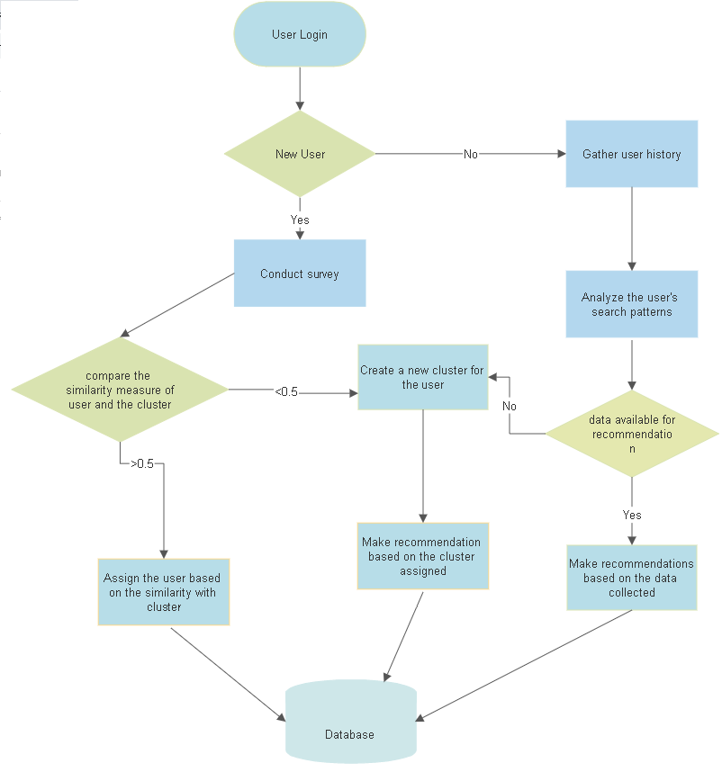
System Architecture

Slide 22
Thank You

